Slide 1

Outcome 1: Transport Infrastructure
Argyll and Bute Community Planning Partnership will improve transport infrastructure by:

Slide 2
ABOIP Agreed Objectives 2024-2034
Working with partners and communities to create a reliable, accessible, affordable and integrated public transport system for Argyll and Bute
Working with partners and communities to ensure a resilient, well-maintained and safe road and active travel network across Argyll and Bute
Working with partners to enhance provision of bespoke transport services for those experiencing the greatest inequality in ease of movement
Contributing to local and national strategic transport plans to ensure the needs of communities experiencing inequalities in transport infrastructure are acknowledged and addressed
Co-producing partners’ plans for elements relating specifically to tackling inequalities in transport infrastructure

Slide 3
CPP Management Committee
14 partners attended June face to face meeting in Arrochar
Short presentations from Cal Mac, Council, Transport Scotland
Positive developments to refine actions for transport including commitment of partner information and resources
Final transport actions to be signed off in September

Slide 4
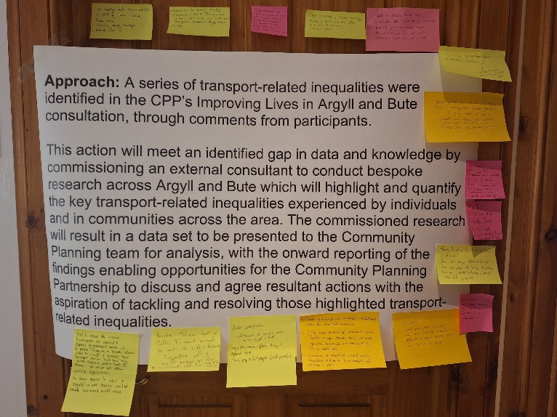
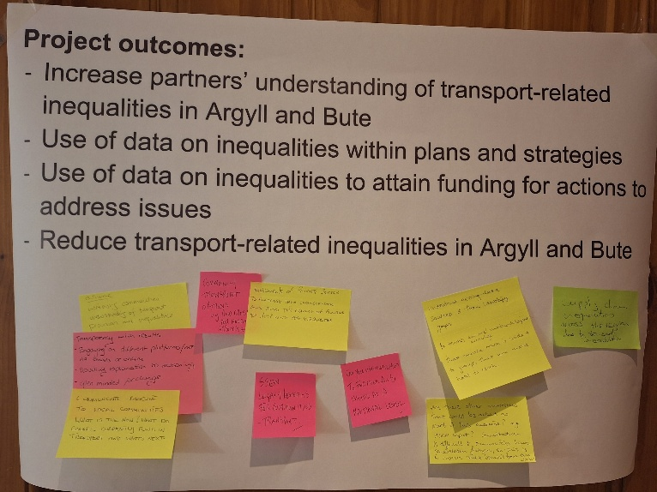
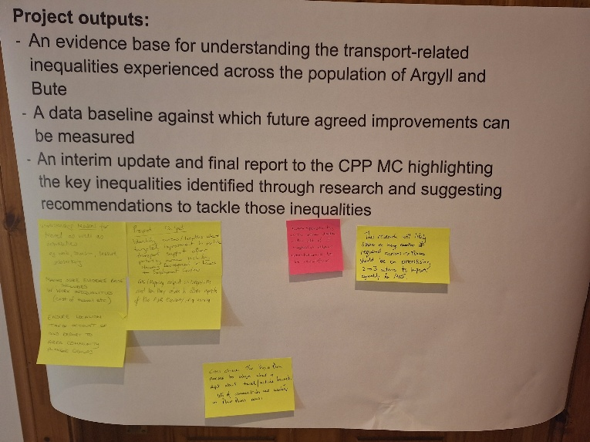
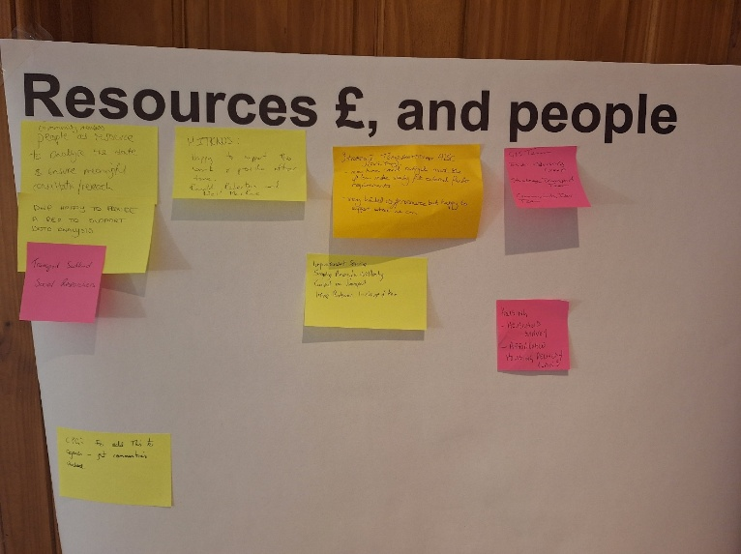
Breakout Groups

Slide 5
Action - Transport Integration Working Group
The community may highlight very localised transport connection issues
Need to think about how the community can innovatively link in to the work of this group – Whatsapp, QR codes; Community leaders are a conduit of information
CALMAC are looking at traffic management and car parking
Apps that can be used to manage costs of shared private transport
DWP potentially has information which would help understand who/ how transport is impacting access to jobs
Dunoon Development Trust and Fyne Futures have Behaviour Change report/results
Transport Scotland have Islands Connectivity Plan and Community Needs Assessments for particular areas
Helensburgh Transport Working Group (ACPG)
Council: Strategic Transport Team, Public Transport Team, Data Advisory Group, Review of Bus Delivery model
Police Scotland – resources to support working group and discussions, e.g. road safety
Use outcomes from pilot projects to inform

Slide 6
Action - Community Active Travel Network
Engage with other organisations that support cycling e.g. Breeze network
Community engagement to understand & influence behaviour change & willingness to undertake Active Travel
Long distance core paths can be separate from roads – cut across country – using eg. forestry roads or legacy roads from construction
Consideration of the leadership role needed to enable this to happen
Understanding of the routes that would yield the greater benefit e.g. what are the journeys people need to make?
Consideration of best practice in other places e.g. Amsterdam made a decision to promote cycling, it didn’t happen accidentally
Future schemes – horizon scanning
Skill sets to support Active Travel - bike maintenance training? - Reuse bike project Lochgilphead
[Active travel network] could be part of bigger initiative, e.g. Climate Challenge Fund
Portfolio of funding streams needed
To encourage Active Travel – bike hire / manage space on ferries

Slide 7

Outcome 2: Housing
Argyll and Bute Community Planning Partnership will improve housing by:

Slide 8
ABOIP Agreed Objectives 2024-2034
Working in effective partnerships to ensure that everyone living and working in Argyll and Bute has access to affordable, warm homes of the right size, in the right place with access to the services, amenities and economic opportunities that communities need to thrive
Ensuring that plans and policies are informed by communities’ needs and aspirations, especially those facing the greatest inequalities in housing related outcomes
Working with partners and communities to ensure that everyone has the ability to have a say in shaping what housing looks like for their place
Reviewing partners’ land and property assets to ensure resources are used effectively to support the provision of housing for key workers and others
Working together to identify opportunities for the prevention of homelessness through early intervention

Slide 9
Questions
Are you aware of any funding, training or opportunities locally for construction skills development?
What data is available for housing locally and what data is missing?
Do you know of any land and assets belonging to your organisation or group that could be used for housing?
What local information could be shared with those at risk of homelessness?
What information do you have about workforce needs for local accommodation?

Slide 10
Bute and Cowal
  Bute
  Rothesay
  Dunoon
  Overall
Community Wellbeing
Transport Infrastructure
Housing
98% +/- 10%
Community Wellbeing
Transport Infrastructure
Housing
94% +/- 10%
Transport Infrastructure
Community Wellbeing
Housing
98% +/- 10%
Transport Infrastructure
Community Wellbeing
Housing
98% +/- 5%

Slide 11
Bute and Cowal – Age

Slide 12
Agreed actions – to be developed
Establish a construction skills development working group
Establish a partner land and assets working group
CPP and ACPG Communication plan on financial interventions to prevent homelessness
Freedom to use Scottish Government housing funding more flexibly and as an allocation with local administrative control
Develop a strategic approach to evidencing the need for workforce housing in the public sector
  Support partners to contribute, providing insights and information and to be part of the creative process on solutions for workforce accommodation

Slide 13
Agreed actions – progressing
Deliver seasonal and temporary workforce accommodation using short term occupancy agreements
Local CPP communication strategy on housing to enhance development of Local Place Plans (complete)
Facilitate discussion at Area Community Planning Groups using existing data and establish any demographic or geographic data gaps (August 2025)
Incorporate energy discussion points within CPP Climate Change Strategy (complete)
CPP to receive briefing on Housing Scotland Bill
Create funding mechanisms for Development Trusts to finance feasibility studies, professional fees and approval process

Slide 14
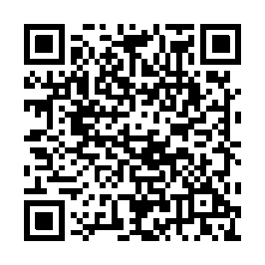
Housing Need and Demand research
Help understand the area’s housing needs and neighbourhoods
Conducted by Research Resource on behalf of the Council
Households previously selected to participate at random
Households now invited to take part in an online survey:
  researchresource.welcomesyourfeedback.net/s/ABC
  Use the QR Code

Slide 15
Questions
Are you aware of any funding, training or opportunities locally for construction skills development?
What data is available for housing locally and what data is missing?
Do you know of any land and assets belonging to your organisation or group that could be used for housing?
What local information could be shared with those at risk of homelessness?
What information do you have about workforce needs for local accommodation?

Slide 16
Next Steps
Engaging Area Community Planning Groups (August and ongoing)
Refining actions and identifying partner input and resources (CPP Management Committee Meeting in September)
Taking actions forward and reporting regularly to CPP groups

Slide 17
Establish a construction skills development working group
The project outputs will be to:
List a set of recommendations that seek to solve the skills issues relating to housing
Take recommendations forward
The project outcomes will be to:
Increase availability of construction skills courses
Increase uptake of construction skills courses
Grow the number of people working in this sector locally in the short, medium and long-term
The project impact will be to:
Have more available and affordable housing in Argyll and Bute

Slide 18
Local CPP communication strategy on housing to enhance development of Local Place Plans
The project outputs will be to:
A communication plan to support community groups in Argyll and Bute to access all relevant sources of information on housing for their Local Place Plans
The project outcomes will be to:
Increase in those accessing information on housing through the Local Place Plan web page.
The project impact will be to:
Housing information reflecting communities’ needs and aspirations is included in Local Place Plans where relevant

Slide 19
Facilitate discussion at Area Community Planning Groups using existing data and establish any demographic or geographic data gaps
The project outputs will be to:
Gain a better understanding of the existing housing-related data available in Argyll and Bute
Agree for each ACPG where there are gaps in housing-related data for that area
Report on the discussions at each ACPG meeting to the CPP MC
The project outcomes will be to:
Facilitate the sharing of housing-related data across Argyll and Bute
Facilitate mechanisms to capture housing-related data where there are identified gaps
The project impact will be to:
Develop an understanding of the areas of greatest inequality in terms of housing availability

Slide 20
Establish a partner land and assets working group
The project outputs will be to:
Have a partner land and asset working group comprising relevant CPP members
Opportunities presented to the CPP Management Committee to support the provision of housing from partners’ existing land and assets within a two year and a five-year timescale, specifically:
  public sector land and buildings which could provide workforce housing via repurposing and change of use
  public sector land and buildings which could provide affordable housing via repurposing and change of use
The project outcomes will be to:
An increase in partner land and assets used to housekey workers and others, and provide affordable housing, within two years and within five years
The project impact will be to:
Increase the availability of housing across Argyll and Bute

Slide 21
CPP and ACPG Communication plan on financial interventions to prevent homelessness
The project outputs will be:
A communication plan to support individuals in Argyll and Bute to access all relevant sources of financial information relating to the prevention of homelessness
The project outcomes will be to:
Increase in those accessing information on financial interventions to prevent homelessness
The project impact will be to:
Reduce the incidence of homelessness in Argyll and Bute caused by financial reasons

Slide 22
Incorporate Energy discussion points within CPP Climate Change Strategy
The project outputs will be to:
Incorporate housing energy efficiency within the CPP climate change strategy
Develop appropriate energy efficiency and affordable heating actions within the associated action plan
Tracking of progress within the climate change strategy and action plan in CPP annual reporting
The project outcomes will be to:
Improve provision of energy efficiency and affordable heating options across Argyll and Bute
Increase awareness in CPP partners of energy efficiency and affordable heating options
The project impact will be to:
Ensure that housing energy efficiency is considered within the scope of the climate change strategy and action plan

